Slide 1


A Presentation on Jabo Application
Hajee Mohammad Danesh Science and Technology University (HSTU)

Slide 2



Submitted by
1.Ujjal roy
ID : 2002033
2.Maharaj Mithu
ID : 2002053
3.Md Sakhawat Hosen
ID : 2002048

Slide 3

Project Supervisor
Md. Rashedul Islam
Associate Professor
Department of CSE, HSTU

Slide 4
Table of Contents
Introduction
Understanding Jabo App
Screenshots
Optimizing Routes
Database
Feedback
Technical Foundation
User Experience
Q&A Session

Slide 5
Introduction
Welcome to the Jabo App Presentation
Introducing Jabo: Your Innovative Path Routing Solution

Slide 6

Understanding Jabo App
What is Jabo App?
Path/Routes-Based Navigation Using Graph Theory
Utilizing Dijkstra's Algorithm and Breadth-First Search

Slide 7

Exploring Jabo's Pages
Dive into Jabo's Six Main Pages
"Home"
"Show Path"
"Add Path"
"Comments/Reports"
"Contact"
"Exit"

Slide 8
The Comprehensive "Home" Page
Discover the Goals and Limitations
Emphasizing Power and Data Availability Constraints

Slide 9
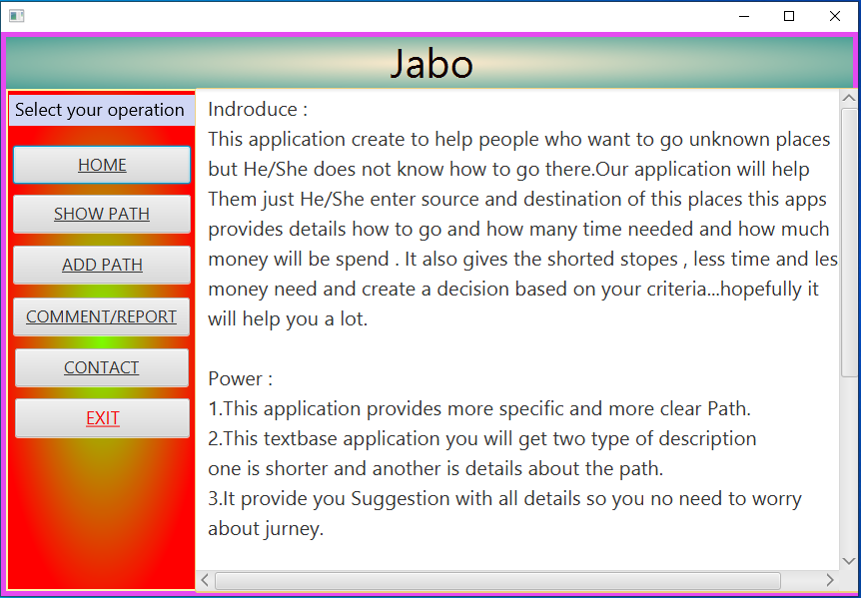
Homepage (Screenshot)

Slide 10

Tailoring Your Travel Experience
The "Show Path" Page
Input Source and Destination
Generate
Textual Path Representation with Arrows
Detailed Description: Cost, Time, Transport Options, Vehicle Availability

Slide 11
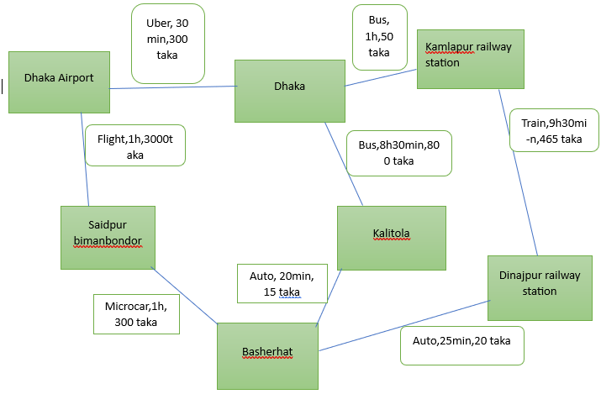
Route Finding Visualization

Slide 12

Optimizing Your Route
Choose Your Travel Preferences
Shortest Cost
Shortest Time
Fewer Stops
Tailor Your Journey to Your Needs

Slide 13
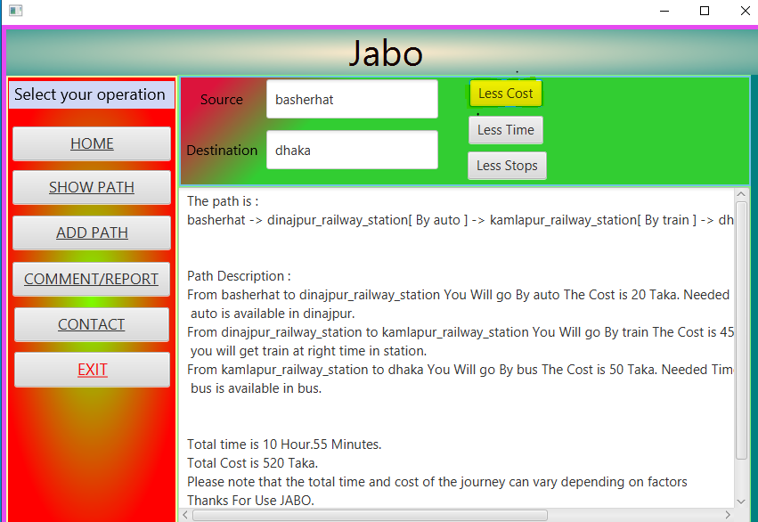
Show Path for Less Cost(screenshot)

Slide 14
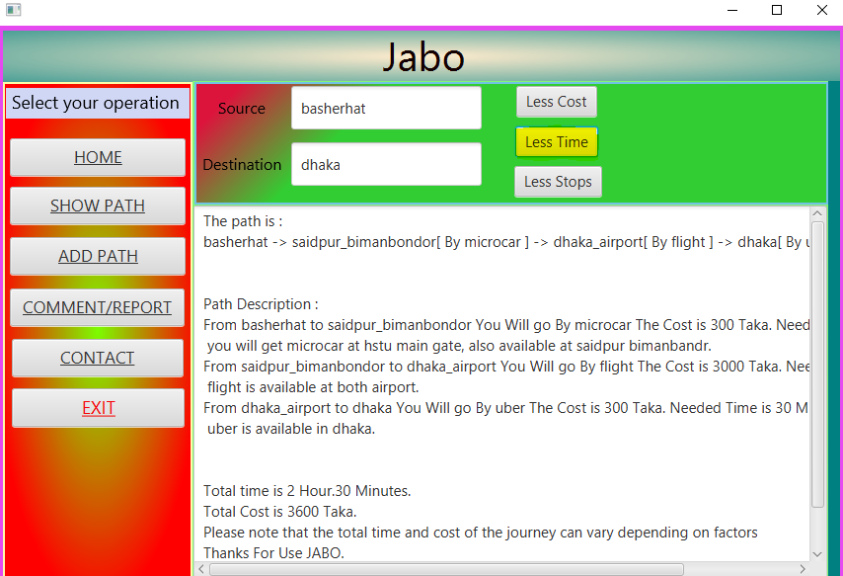
Show Path for Less Time(screenshot)

Slide 15
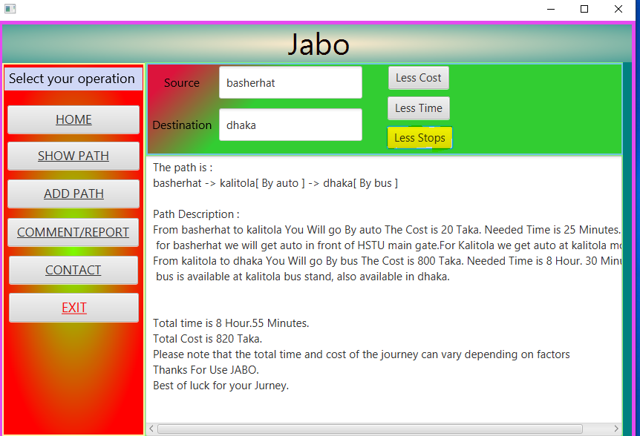
Show Path for Less Stops(screenshot)

Slide 16

Enriching the Database
The Power of the "Add Path" Page
User Contributions: Enhancing the Database
Future Users Benefit from Expanded Route Options

Slide 17
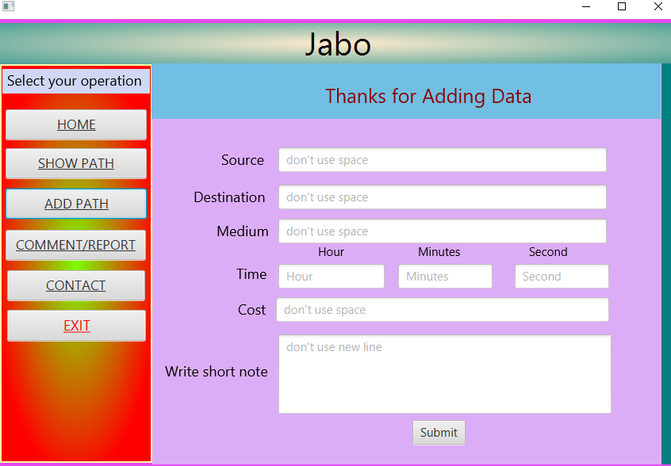
Add path(screenshot)

Slide 18
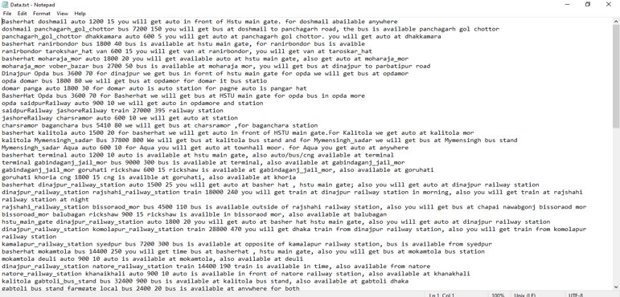
Database (screenshot)

Slide 19
Providing Feedback
Improve with the "Comments/Reports" Page
User Feedback and Issue Reporting
Continuous Enhancement and Issue Resolution

Slide 20
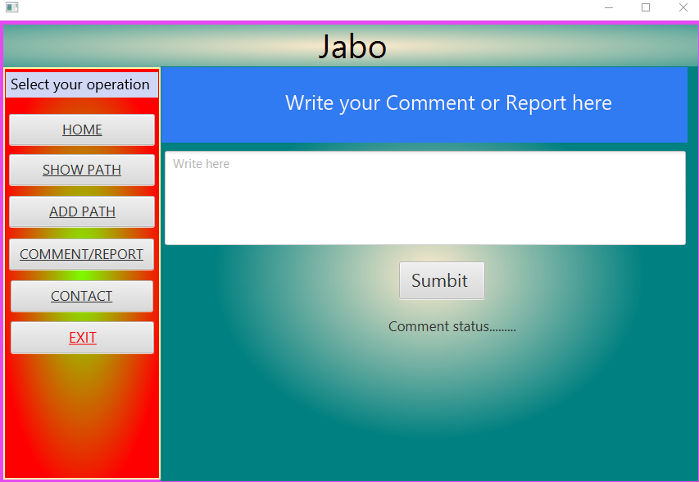
Comment (Screenshot)

Slide 21
Connecting and Engaging
Communicate Directly via the "Contact" Page
Engage with the Project Team
Address User Inquiries and Concerns Effectively

Slide 22
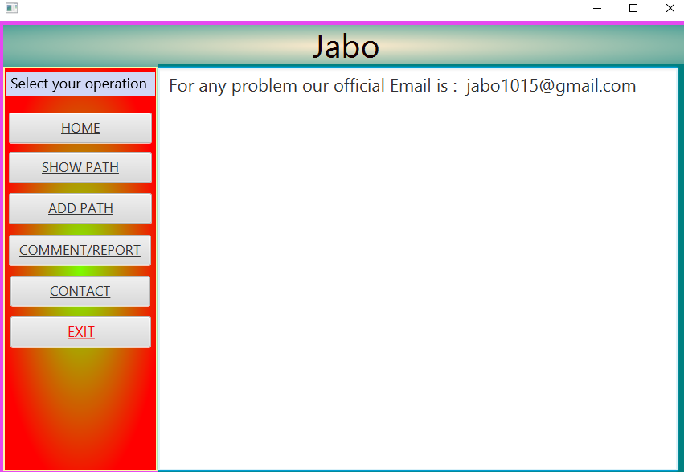
Contact (screenshot)

Slide 23

Jabo's Technical Foundation
Built with Java Programming Language
Designed with JavaFX for Windows Compatibility
Developed Using NetBeans IDE
Impressive Computational Capabilities: Analyzing One Core Place per Second

Slide 24
Enhancing User Experience
Empowering Journey Planning
Employing Graph Theory Algorithms
Harnessing User-Contributed Data

Slide 25

Overcoming Challenges
Facing Limitations with Extensive Databases
Potential Output Errors Due to Misspellings
Continuous Efforts to Optimize Results

Slide 26

The Vision and Impact
Jabo's Purpose: Efficient Routes Based on Transportation Needs
Offering Options for Shortest Path, Minimal Cost, and Minimum Time
Contributing to Accessibility, Cost Savings, Environmental Benefits, and Community Engagement

Slide 27

User Testimonials
Highlighting the Positive Impact of Jabo App
Real-World Experiences and Success Stories

Slide 28

Get Started with Jabo App
Download and Join the Jabo Community
Start Navigating Efficiently and Collaboratively

Slide 29

Q&A Session
Open the Floor for Questions and Answers
Clarify Any Doubts About Jabo App

Slide 30
Contact Information
Mail : jabo1015@gmail.com

Slide 31

Thank You
Express Appreciation to the Audience
Encourage Exploration and Feedback

